Slide 1

DDS Analytics Talent Management Solutions Consulting Team: Tanvi Arora Rebecca Holsapple Anjli Solsi Anne Francomano
TARA Pharma Corp.
Proof-of-Concept
Workforce Attrition Analysis
August 7, 2018

Slide 2
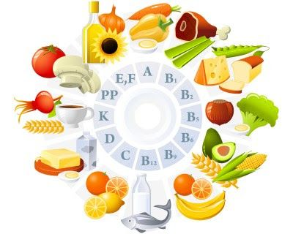

Background – TARA Pharma Corp.
Respected dietary supplement product lines
Development
Manufacturing
Marketing
Seattle workforce marketplace climate
Fierce competition for talented new hires
Some firms entice away competitors’ employees
STRATEGY DATA SCIENCE + TALENT MANAGEMENT
INVESTIGATE
Prepared by DDS Analytics for

Slide 3
Proof-of-Concept Analysis Core Objectives
Identify the top three factors contributing to top-performing employee attrition in three departments
Human Resources
Research & Development
Sales
Identify job role specific trends
Prepared by DDS Analytics for

Slide 4
Overview
Analysis Tool
R supports reproducibility
Data Source
Qualtrics combined its survey results with TARA Personnel data
All identifiable information was stripped out, e.g. name, date of birth et al.
Compiled into a single Excel workbook
FY 2017
1470 unique employee entries
Three departments: Human Resources, Research & Development, and Sales
Performance Rating: 3 (“Excellent”) or 4 (“Outstanding”)
Prepared by DDS Analytics for

Slide 5
Data Source
Qualtrics Survey-Related Ratings
Environment Satisfaction Job Satisfaction Job Involvement Relationship Satisfaction | Work Life Balance
Low Medium High Very High | Bad Good Better Best
Prepared by DDS Analytics for

Slide 6
Data Source (continued…)
TARA Personnel Records FY2017
Age Over 18 (y/n) Gender Total Working Years Education Education Field Marital Status Number of companies worked prior to TARA Commuting Distance | Employee Number Employee Count Attrition (y/n) | Department Job Role Job Level Business Travel Stock Options Level OverTime (y/n) Standard Hours Years with Current Manager Years at TARA | Percent Salary Hike Monthly Income Monthly Rate Daily Rate Hourly Rate | Performance Rating Years in Current Role Years since Last promotion Training Time Used Last Year
Individual | Status | Position | Compensation | Performance
Please see codebook for full details.
Prepared by DDS Analytics for

Slide 7
Data Quality Overview
No indication of missing data
Renamed field names to comply with TARA 12 character standard
Added descriptive fields for some information that used number-based ratings
E.g. Performance rating 3 is equivalent to “Excellent”
Useful for reporting purposes
Converted some data fields to make it clear that the data represented categories, not continuous measurement data.
Qualtrics had already removed individuals under 18
Prepared by DDS Analytics for

Slide 8
Top-Performer Percent Attrition by Department
Department | Top Performer Percent Attrition FY 2017
Human Resources | 19.05%
Research & Development | 13.84%
Sales | 20.63%
As TARA expected, FY2017 attrition rates are higher in these three departments
Ideally keep attrition as close to 0 as possible for top performers
Prepared by DDS Analytics for

Slide 9

Preliminary Analysis
35 Variables
2 Variables NOT utilized due to no response variation
Standard Hours
Employee Count
Prepared by DDS Analytics for

Slide 10
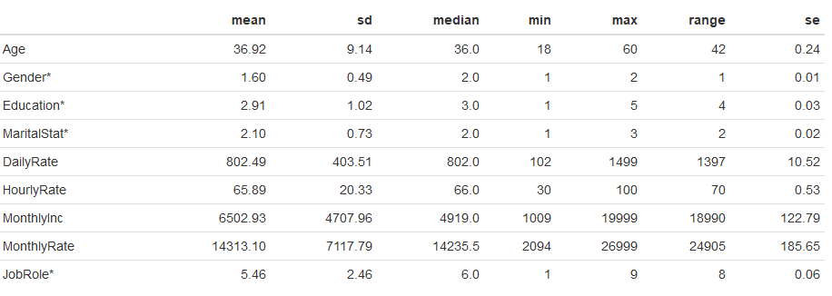
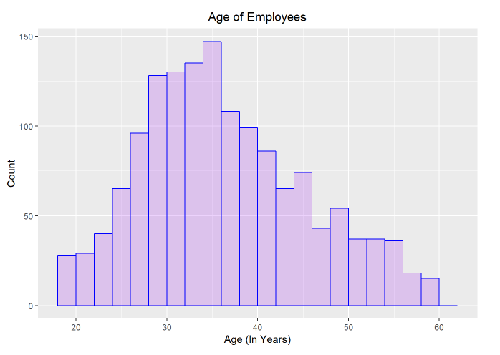
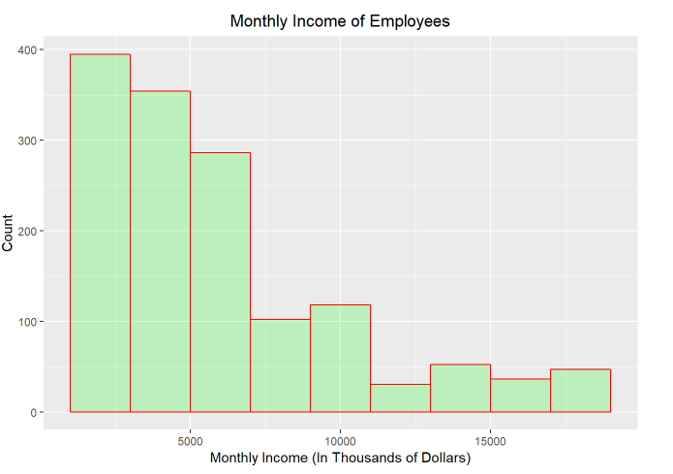
Descriptive Statistics
Exploratory Data Analysis
Prepared by DDS Analytics for

Slide 11


Breakdown Frequencies and Counts
Management Level 5 | Head Count
Manager | 43
Research Director | 26
Total | 69
Men = 60%
Women = 40%
Manager
7%
Research Director
5%
Education | Head Count | Percentage
Below College | 170 | 12%
College | 282 | 19%
Bachelor | 572 | 39%
Master | 398 | 27%
Doctor | 48 | 3%
Sales Exec
22%
Sales Rep
5%
Manufacturing Director
10%
Healthcare Rep
9%
Research Scientist
19%
Lab Tech
17%
HR
3%
Prepared by DDS Analytics for

Slide 12
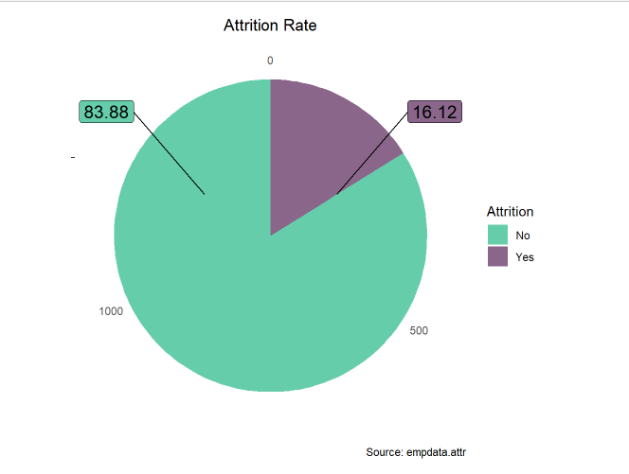
Are you losing your best talent ?
If your top performers are leaving, it’s time to figure out why they are leaving and make the changes necessary to retain your top talent
Prepared by DDS Analytics for

Slide 13
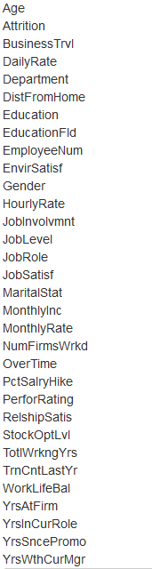
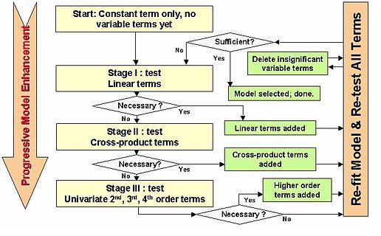
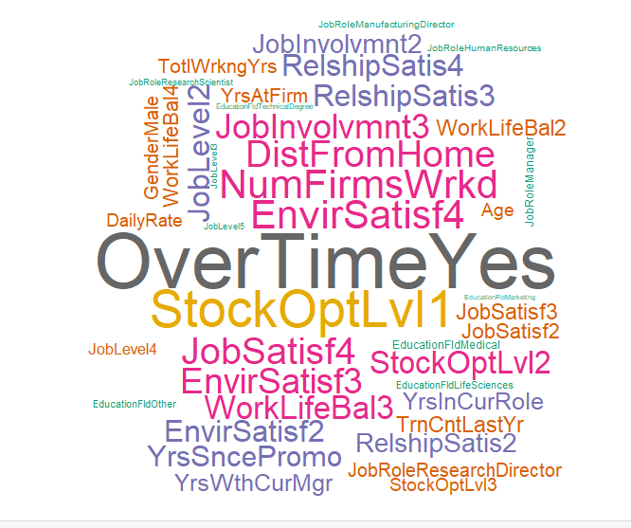
Our Model
Initial Model
Prediction Model
Top variables
AIC
901.66
AIC
884.02
Prepared by DDS Analytics for

Slide 14

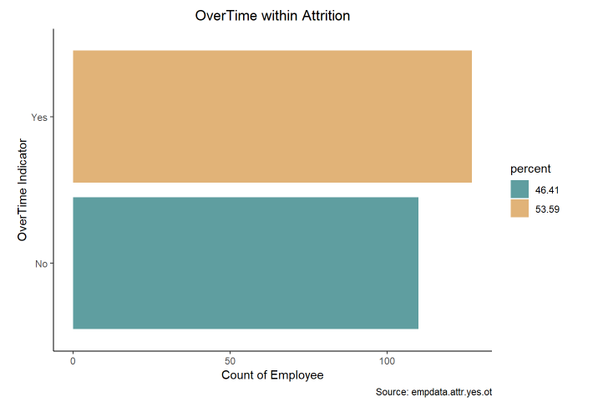
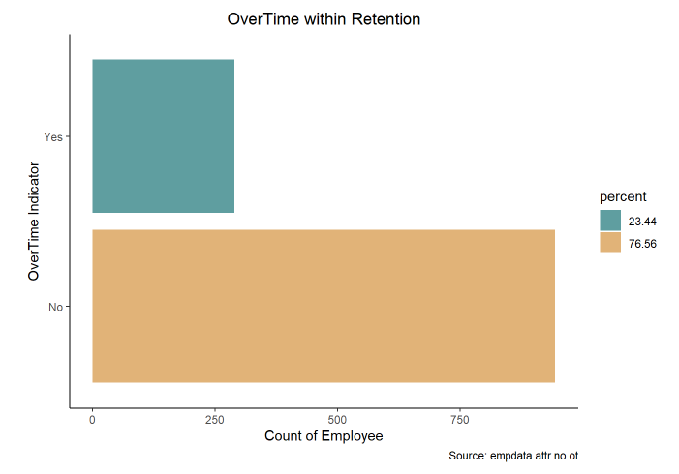
OverTime
Is compensation good enough ?
Is it causing employee burnout ?
Prepared by DDS Analytics for

Slide 15
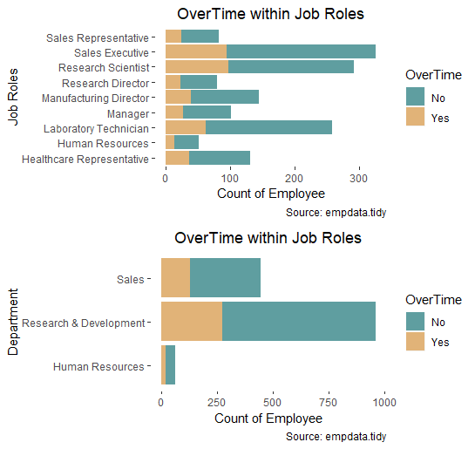
Prepared by DDS Analytics for

Slide 16

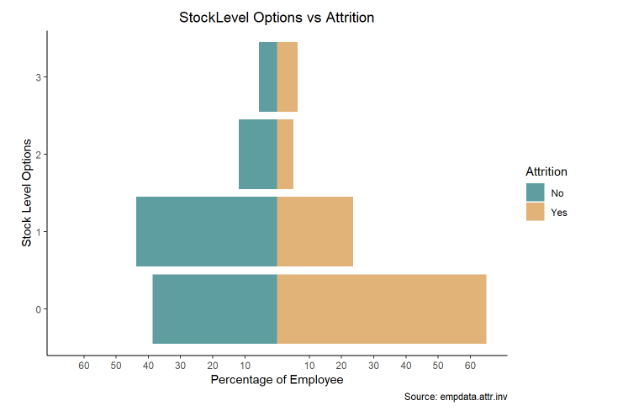
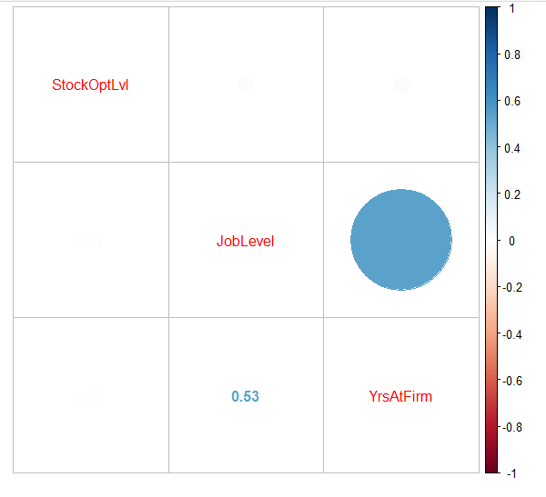
StockOptions
Correlation Matrix
Prepared by DDS Analytics for

Slide 17
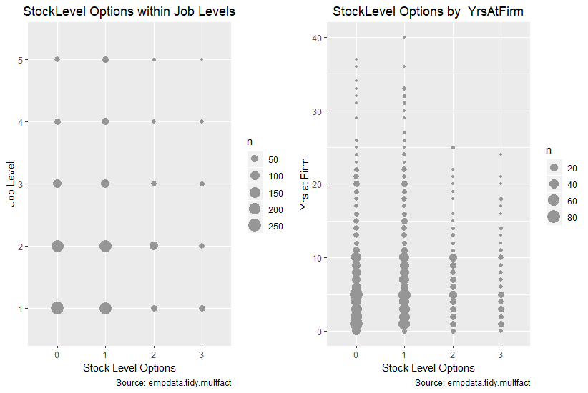
Prepared by DDS Analytics for

Slide 18
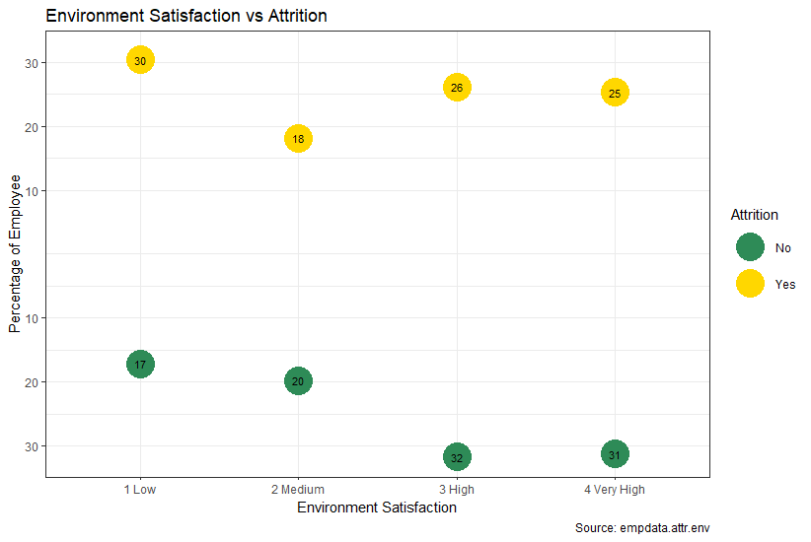
Environment Satisfaction
25%
30%
32%
17%
Prepared by DDS Analytics for

Slide 19
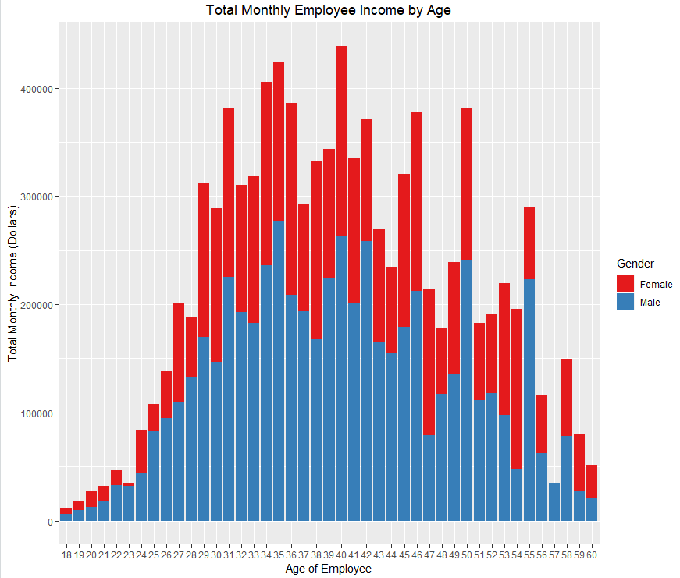


Age and Overall Monthly Income
Prepared by DDS Analytics for

Slide 20
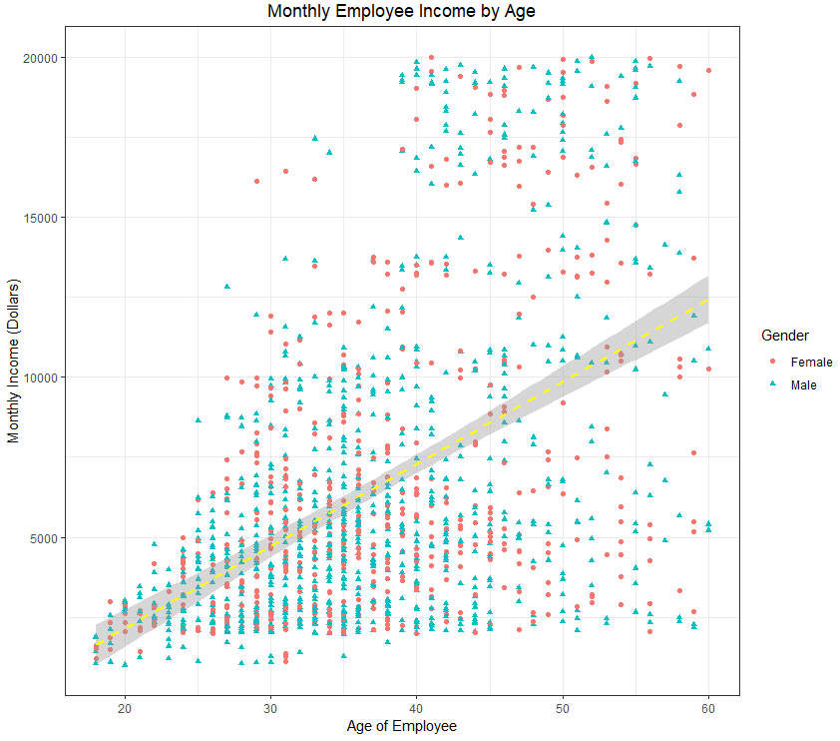
Age and Income
Prepared by DDS Analytics for

Slide 21

Top Factors Affecting Overall Employee Work-Life Satisfaction with Average Rating
Work Life Balance:
2.76
Work-Relationship Satisfaction:
2.71
Job Satisfaction:
2.73
Performance Rating:
3.15
Job Involvement: 2.73
Environment Satisfaction: 2.72
Prepared by DDS Analytics for

Slide 22
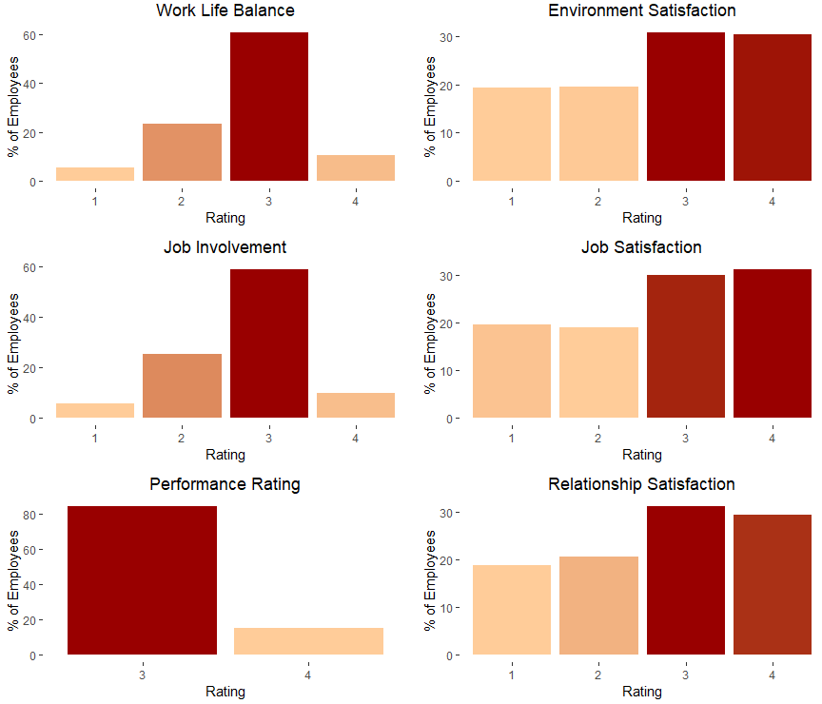




Work-Life Satisfaction
Ratings:
Low/Bad
Medium/Good
High/Excellent/Better
Very High/Outstanding/Best
Prepared by DDS Analytics for

Slide 23
Summary – Insights for Top-Performers in Three Key Departments
Overall FY2017 Attrition Rate will damage TARA if it continues
Top Three Contributors to Attrition:
Overtime Burnout risk
Sales Executive, Research Scientist, Laboratory Tech
Stock Option Level ~65% of those leaving had stock option level 0
Level not correlated to Years At Firm or Job Level
Environment Satisfaction ~30% of those leaving had low level response rating
Prepared by DDS Analytics for

Slide 24
Summary – Insights for Top-Performers in Three Key Departments (continued…)
Income and Age are Related Overall
Income grows initially with age and gradually declines
Income for males exceeds income for females
Work-Life Satisfaction is Important
Most used top two ratings for Satisfaction-related survey responses
Majority of average response ratings land close to each median
Prepared by DDS Analytics for

Slide 25
Summary - Recommendations
Consider revising Stock Option Level 0 plans
Engage employees on a regular basis
Feedback for immediate supervisor
More frequent employee appreciation activities
Periodic team building activities
Consider that equal compensation is extremely important to women evaluating job opportunities when TARA extends job offers
Closely monitor how much over time is being accrued, by which employees and why, with the goal of avoiding employee burnout and enhancing the work environment.
Prepared by DDS Analytics for

Slide 26
Summary – Analysis Improvements
1. Utilize more advanced modeling techniques, such as random forest for prediction, and Baruto for variable importance, which is built on random forest method. 2. Model Job Satisfaction and Relationship Satisfaction within Attrition, as done in the proof-of-concept analysis with Stock Option Level and Environment Satisfaction.
Prepared by DDS Analytics for

Slide 27
Prepared by DDS Analytics for

